Slide 1
Generating Precise
Radial Velocities
Sharon Xuesong Wang
Tsinghua University, Department of Astronomy
@sharonxuesong
2024 ABDECII High Resolution Spectroscopy
Notes:
- Overall basic introduction on what is RV and what and how we are measuring it. - When you receive a RV time series from your collaborators, what are you looking at and what they mean and what to look for and caveats and all that. - Some quick but a bit in depth introduction on extracting RVs from spectra.

Slide 2
Ex Lab
Stellar Astro, Earth 2.0
Know Thy Star, Know Thy Planet
Exoplanet Demographics
Search & characterize;
Probe formation & evolution.
Tsinghua ExoLab
contact: sharonw@tsinghua.edu.cn, @sharonxuesong

Slide 3
Outline
- What is radial velocity? What are we measuring?
- What to expect when you work with RV data?
- How exactly do we get RVs from data?

Slide 4
Prelim
- Some slides are dense – focus on larger words.
- Focus on overview and practical use.
- Will have references for going in-depth on some topics at the end.

Slide 5
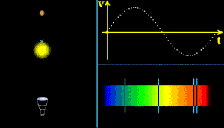
Velocity along line of sight
positive = redshifted = going away
Notes:
illustration of what is radial velocity

Slide 6
RV Components
Reference frame: your spectrograph
Relative velocity between the star and solar system
Notes:
what contributes to a star’s radial velocity

Slide 7
RV Components
Reference frame: your spectrograph
Relative velocity between the star and solar system
Relative velocity between the Earth and the barycenter
Notes:
what contributes to a star’s radial velocity

Slide 8
RV Components
Reference frame: your spectrograph
Relative velocity between the star and solar system
Relative velocity between the Earth and the barycenter
Rotation of the Earth
Notes:
what contributes to a star’s radial velocity

Slide 9
RV Components
Reference frame: your spectrograph
Relative velocity between the star and the solar system
Relative velocity between the Earth and the barycenter
Rotation of the Earth
Notes:
what contributes to a star’s radial velocity

Slide 10
RV Components
Reference frame: your spectrograph
Relative velocity between the star and solar system
Relative velocity between the Earth and the barycenter
Rotation of the Earth
Reference frame: the barycenter of solar system
Notes:
what contributes to a star’s radial velocity

Slide 11
RV Components
Reference frame: your spectrograph
Relative velocity between the star and solar system
Relative velocity between the Earth and the barycenter
Rotation of the Earth
Reference frame: the barycenter of solar system
Relative velocity between the star and solar system
Systemic velocity of the star
Velocity of the star around the barycenter of its system (companions including planets)
Notes:
what contributes to a star’s radial velocity

Slide 12
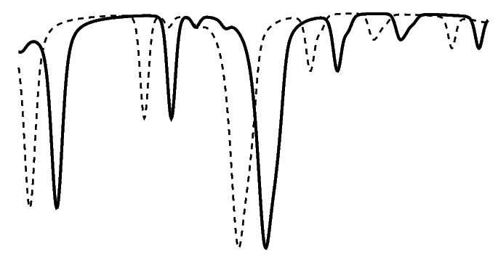
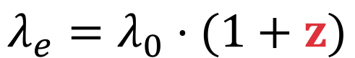
flux
$$λ_{e}=λ_{0}⋅(1+z)$$
t = t₀
t = t_{e}
wavelength
Notes:
what are we actually measuring?
spectra at different epoches
wavelengths for spectrum at each epoch
Doppler shift between each spectrum with respect to reference
corrects for BC -> net RV of the star, plus an error bar on that

Slide 13

In reality,
we are measuring $ΔRV$ in the lab frame.
RV change of the star w.r.t. an arbitrary time frame
=> arbitrary RV offset
Need to translate into barycentric frame.
=> barycentric correction

Slide 14
What do we actually measure?
Spectra at different epochs
Wavelengths for spectrum at each epoch
Doppler shift between each spectrum w.r.t. reference
Barycentric correction
Notes:
what are we actually measuring?
spectra at different epoches
wavelengths for spectrum at each epoch
Doppler shift between each spectrum with respect to reference
corrects for BC -> net RV of the star, plus an error bar on that

Slide 15
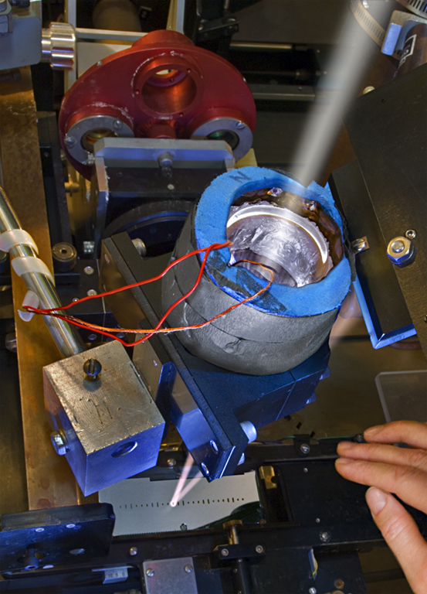
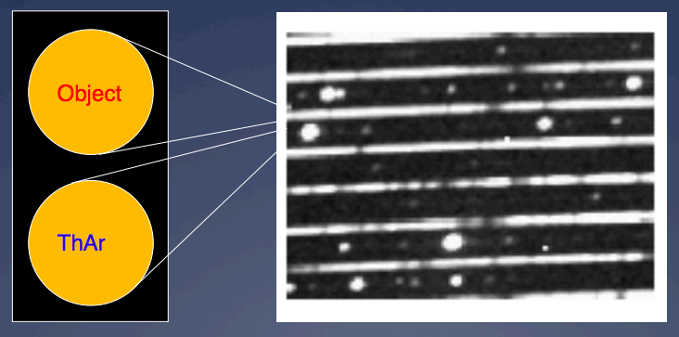
Iodine Cell Calibrated
e.g. Keck/HIRES
copy right LaurieHatch.com
ThAr Calibrated
e.g. HAPRS
slide from Christophe Lovis
Notes:
So how do we get RVs out?
Two types of instruments based on calibration methods.

Slide 16
Absorption Cell Calibrated
e.g. Keck/HIRES, CRIRES
copy right LaurieHatch.com
Simultaneous Reference
e.g. HAPRS, ESPRESSO
slide from Christophe Lovis
Notes:
So how do we get RVs out?
Two types of instruments based on calibration methods.

Slide 17
How do we get RVs out?
Cross Correlation Function (CCF)
used for stabilized spectrographs.
(or getting less-precise RVs)
Baranne et al. 1996
Forward Modeling
used for both calibration methods.
Butler et al. 1996, Anglada-Escudé & Butler 2012
Notes:
So how do we get RVs out?
CCF
forward modeling, esp for iodine-calibrated instruments

Slide 18
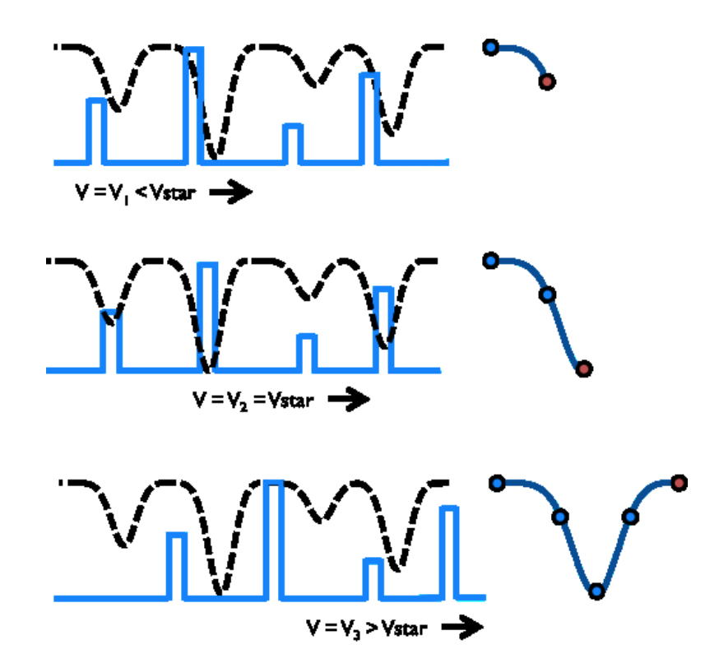
CCF
Roy et al. 2016
Notes:
CCF

Slide 19
Forward Modeling
– iodine lines
– stellar lines
• observation
Notes:
forward modeling

Slide 20

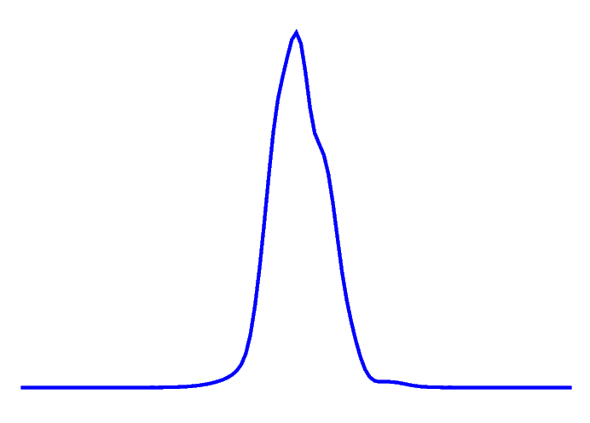
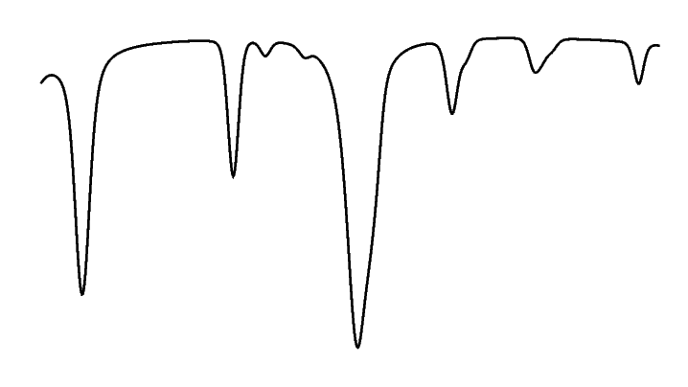
Iodine or other absorption cell
Model
Reference Spectra
Model Parameters
Iodine Atlas
Line Spread Function
t = t_{e}
t = t₀
Wavelength Solution
including z
Stellar Template
Notes:
forward modeling

Slide 21
Simultaneous reference
Model
Reference Spectra
Model Parameters
Adding Multiple Epochs
Stable LSF (no need to model)
t = t_{e}
t = t₀
Wavelength Solution
including z
Stellar Template
Notes:
forward modeling

Slide 22
All things equal, under idealized situations*,
CCF = Forward Modeling
*Same photon noise, same template, eliminating contamination completely, no stellar variation
*With proper and reliable continuum normalization
Notes:
First
Photon limited precision within reasonable range
No algorithmic errors IF implemented properly
Been tested repeated with synthetic data
Bench marks for future algorithm
One more word on continuum normalization

Slide 23
About the stellar reference spectrum…
(or the stellar template, in some cases)
- They are typically empirically derived.
Deconvolution, Butler et al .1996
Customized masks for the CCF method, Baranne et al. 1996
Shift and stack many frames, Anglada-Escudé & Butler 2012
- You don’t absolutely need them, actually.
(But life is a whole lot easier if you do…)
“The grand solution” (Jeff Valenti), Gao et al. 2016 for CSHELL
PSOAP, Czekala et al. 2017
Wobble, Bedell et al. 2019

Slide 24
How do we get RVs out?
Cross Correlation Function (CCF)
Pro: quick and simple.
Con: relies on stabilized spectrograph; hard to deal with tellurics or variations in spectral PSF.
Forward Modeling
Pro: versatile – can add component and deal with changing PSF.
Con: algorithmically and computationally more challenging.
Notes:
So how do we get RVs out?
CCF
forward modeling, esp for iodine-calibrated instruments

Slide 25
What do we actually measure?
Spectra at different epochs
Wavelengths for spectrum at each epoch
Doppler shift between each spectrum w.r.t. reference
Barycentric correction
Notes:
what are we actually measuring?
spectra at different epoches
wavelengths for spectrum at each epoch
Doppler shift between each spectrum with respect to reference
corrects for BC -> net RV of the star, plus an error bar on that

Slide 26
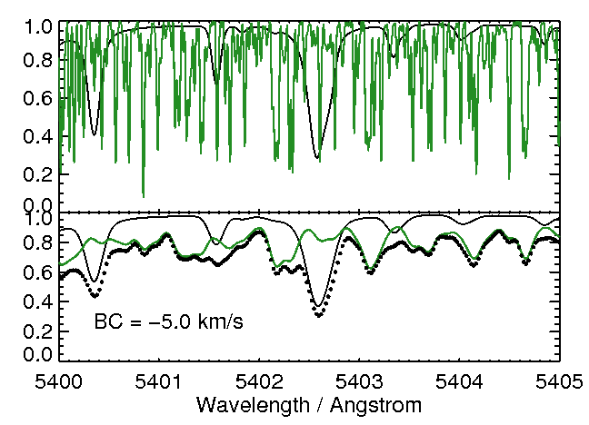
1 m/s ~ 1/ 1000th pixel
… and the largest component in your signal comes from the Earth!

Slide 27
Quick manual for using
typical RV products
Time / BJD
RVs
Errors
SHK/Ha…
2459999.12345
21316.78
1.23
0.48323
Do not be alarmed if you RVs have an arbitrary constant offset (which could be a pretty large number sometimes).
The errors on the RVs are the “internal” errors reported from the data analysis for a single epoch. Typically representing the photon-limited precision. Quite often underestimated due to omitted instrumental and stellar jitter.
Notes:
typical RV data used in detecting planets: BJD, RV, error; caveats about each.

Slide 28
What is the “RV precision” ?
Photon-limited RV precision: (your typical “error bar”)
Instrument RV precision:
On-target RV precision:
Notes:
What are we talking about when we talk about RV precisions?

Slide 29
What is the “RV precision” ?
Photon-limited RV precision: (your typical “error bar”)
The best you will ever get because of information content of the stellar spectrum, amount of photons you get, and your calibration method.
Instrument RV precision:
On-target RV precision:
Notes:
What are we talking about when we talk about RV precisions?

Slide 30
What is the “RV precision” ?
Photon-limited RV precision: (your typical “error bar”)
The best you will ever get because of information content of the stellar spectrum, amount of photons you get, and your calibration method.
Instrument RV precision:
What your instrument is capable of, set by the intrinsic stability of the instrument and your calibration method (and even data analysis method). Often quoted as “goals” for new instruments.
On-target RV precision:
Notes:
What are we talking about when we talk about RV precisions?

Slide 31
What is the “RV precision” ?
Photon-limited RV precision: (your typical “error bar”)
The best you will ever get because of information content of the stellar spectrum, amount of photons you get, and your calibration method.
Instrument RV precision:
What your instrument is capable of, set by the intrinsic stability of the instrument and your calibration method (and even data analysis method). Often quoted as “goals” for new instruments.
On-target RV precision:
Set by the two terms above, plus stellar jitter and stellar activity. Often we try to estimate the best performance possible for an instrument by observing RV standard stars (quiet and no planet).
Notes:
What are we talking about when we talk about RV precisions?

Slide 32

the 7 components of precise RV
stellar
variation
stable
spectrograph
tellurics
input
data analysis
star
calibrator
ERPVII, Fischer+2016

Slide 33
the 7 components of precise RV
astrophysics
hardware
stellar
variation
software
stable
spectrograph
tellurics
input
data analysis
star
calibrator
ERPVII, Fischer+2016

Slide 34
flux
z = z_{star} + z_{planet}
t = t₀
t = t_{e}
wavelength

Slide 35
flux
z = z_{star} + z_{planet}
t = t₀
t = t_{e}
wavelength
See, e.g., Davis et al. 2017, Cretignier et al. 2021

Slide 36
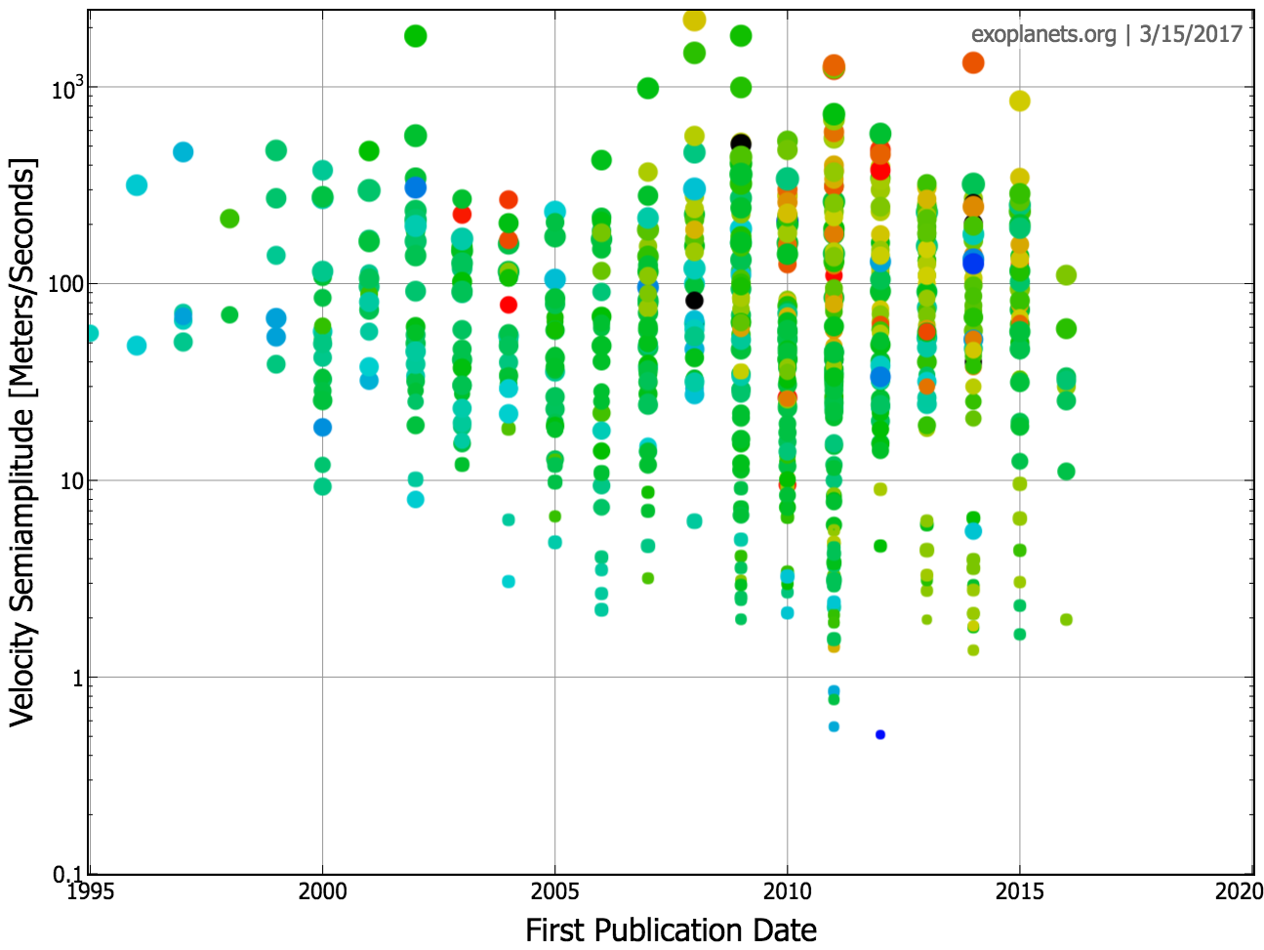
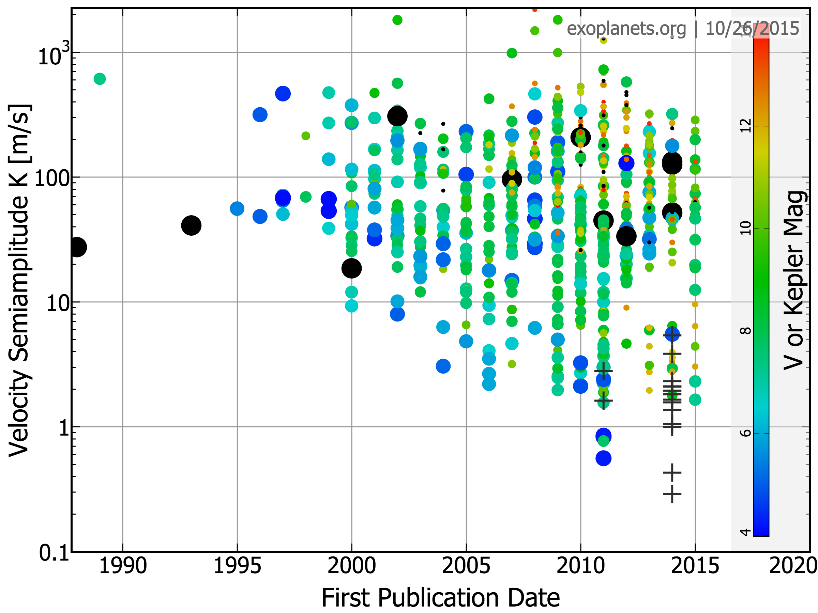
Towards 10 cm/s precision for Earth 2.0
10³
12
10
10²
V or Kepler Magnitude
8
Velocity Semiamplitude K [m/s]
10
6
HET/HRS
4
Keck/HIRES
2 m/s
HARPS-S
PFS
HRS2 PFS2
1
APF
Keck/HIRES
HARPS-N
MINERVA
CARMENES
NEID
Earth
Neptune
Jupiter
ESPRESSO
& EXPRESS
0.1
1995
2000
2005
2010
2015
2020
First Publication Date

Slide 37
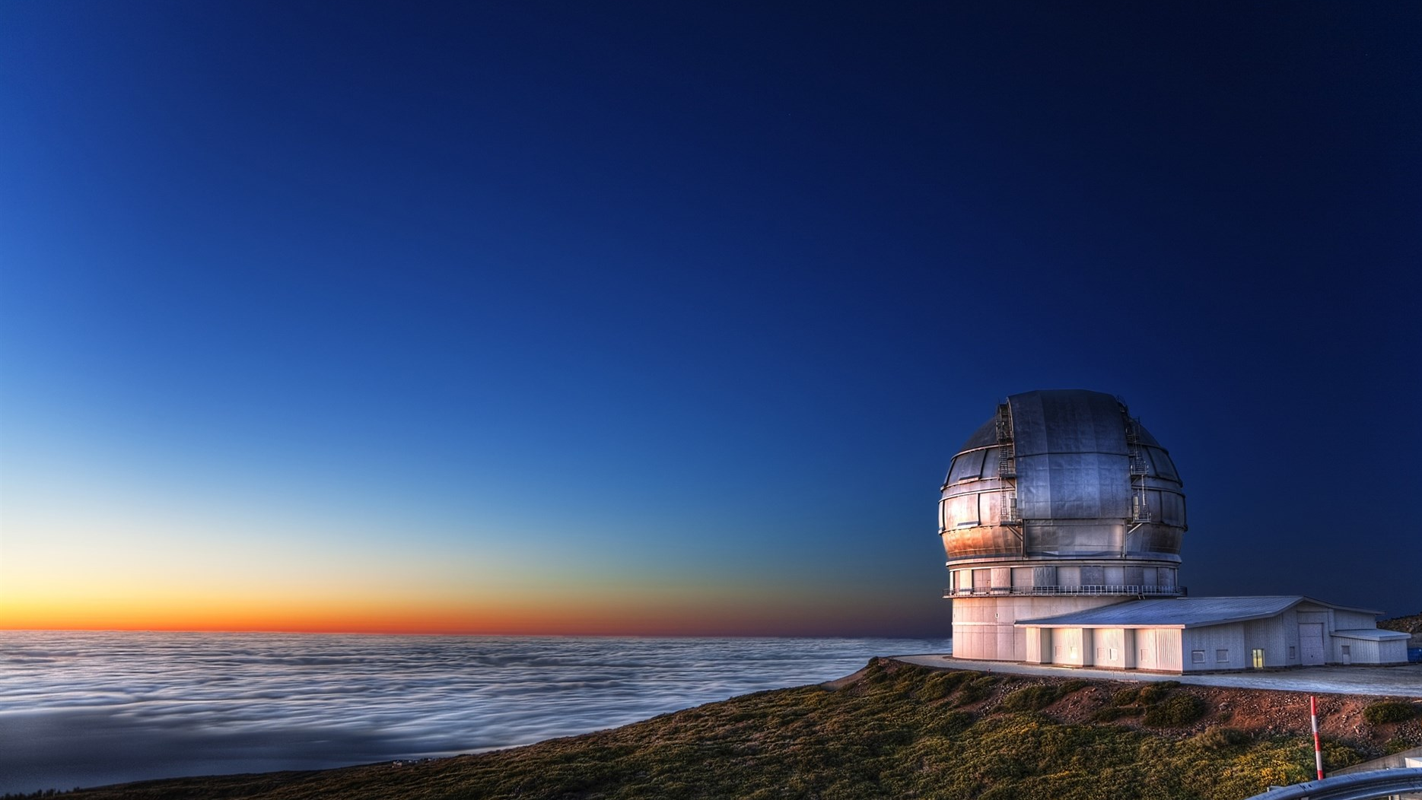
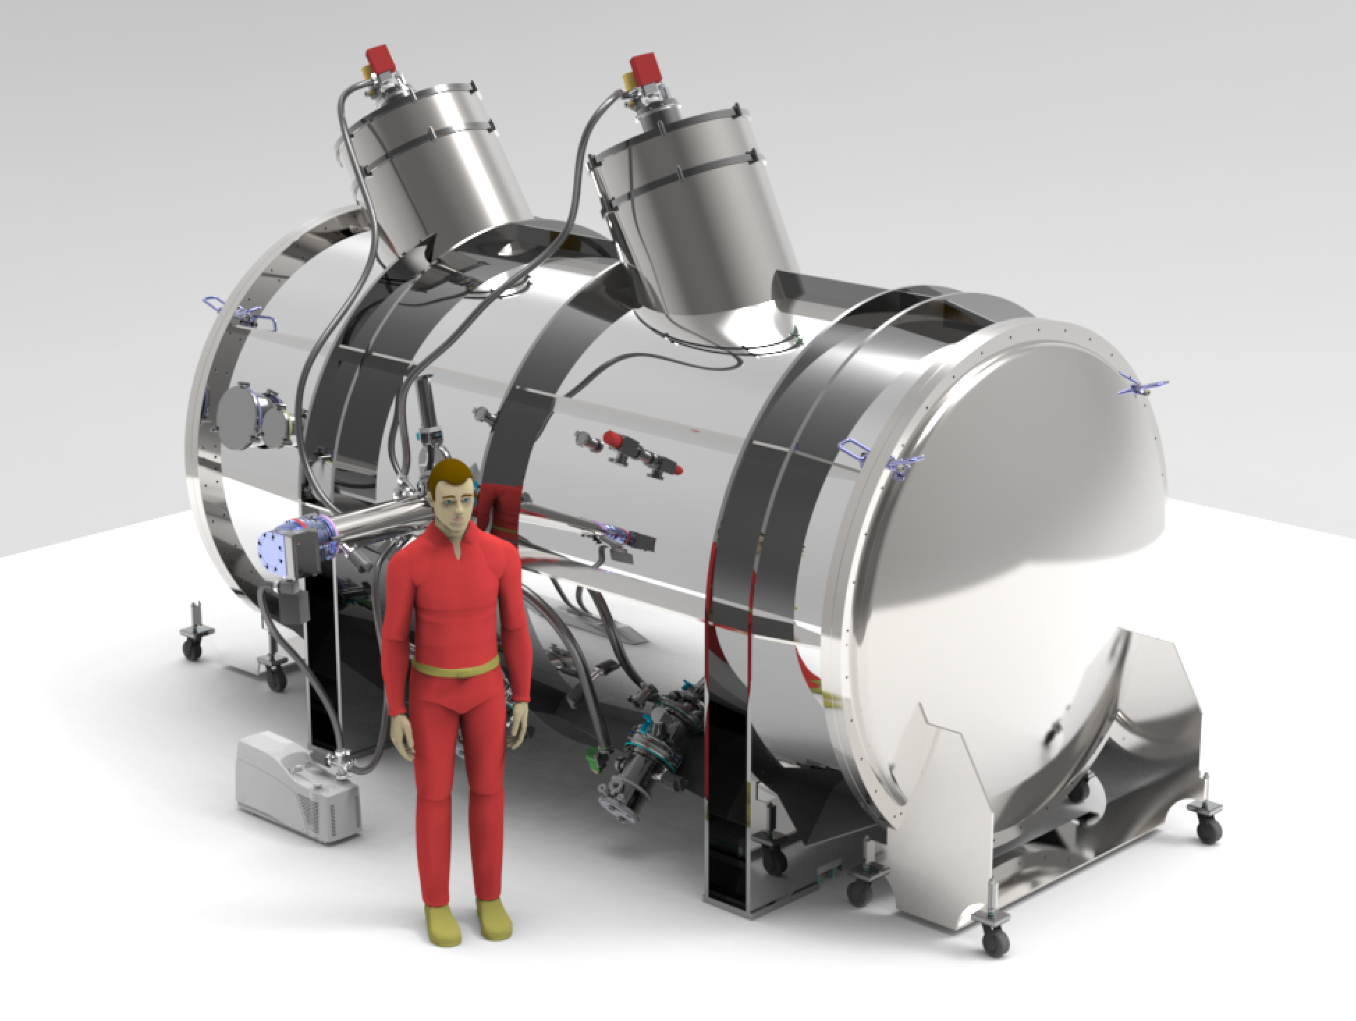





CHORUS
Canarian Hybrid Optical high-Resolution Ultra-stable Spectrograph
CHORUS
预计2027-2028建成投入使用
换取中国10%GTC时间，任何仪器
VIS视向速度精度10 cm/s
UVS覆盖310-410+ nm，~3万分辨率
搜寻地球2.0，刻画行星大气，银河系考古
PI：刘继峰
Co-PI：施建荣
Chief Engineer：张凯
Project Scientist：王雪凇
Data Lead: 王靓

Slide 38
Thank You
& questions welcome
Sharon Xuesong Wang
sharonw@tsinghua.edu.cn
@sharonxuesong
Notes:
thank you and contact

Slide 39
Overall introduction to the RV technique and the field:
Radial Velocity as an Exoplanet Discovery Method, Wright
https://arxiv.org/abs/1707.07983
Radial Velocity Techniques for Exoplanets, Lovis & Fischer
http://exoplanets.astro.yale.edu/workshop/EPRV/Bibliography_files/Radial_Velocity.pdf
Status of the Field, Fischer et al EPRV2, 2016
https://arxiv.org/abs/1602.07939
Textbook: The Doppler Method for the Detection of Exoplanets, by A. Hatzes
2018 and 2020 Sagan Summer Workshops
Citations in this presentation:
Butler et al. 1996:
http://adsabs.harvard.edu/abs/1996PASP..108..500B
Baranne et al. 1996
http://adsabs.harvard.edu/abs/1996A%26AS..119..373B
Anglada-Escude & Butler 2012
https://arxiv.org/abs/1202.2570
Gao et al. 2016
http://adsabs.harvard.edu/abs/2016PASP..128j4501G
Davis et al. 2017
http://adsabs.harvard.edu/cgi-bin/bib_query?arXiv:1708.00491
Czekala et al. 2017
http://adsabs.harvard.edu/abs/2017ApJ...840...49C
Roy et al. 2016
https://arxiv.org/abs/1607.06485
Cretignier et al. 2021
﻿http://arxiv.org/abs/2106.07301
Notes:
Suggested intro references for RVs

Slide 40
A Tally Sheet for RV Instruments:
Compiled by CARMENES group (last updated ~2016?):
http://carmenes.caha.es/ext/instrument/index.html
New and commissioning RV instruments, 2017, EPRV3 meeting:
https://arxiv.org/abs/1801.05383
RV Extraction Codes:
Iodine:
Pyodine by Heeren & Tronsgaard
https://arxiv.org/abs/2306.13615
Simultaneous reference:
SERVAL by Zeichmeiseter
https://arxiv.org/abs/1710.10114
LBL by Artigua
https://arxiv.org/abs/2207.13524
YARARA by Cretignier (not public?)
https://arxiv.org/abs/2308.11812
Wobble by Megan Bedell
https://arxiv.org/abs/1901.00503
Barycentric correction:
barycorr code
https://astroutils.astronomy.osu.edu/exofast/barycorr.html
Python version
https://github.com/shbhuk/barycorrpy

Slide 41

Backup Slides

Slide 42
What can go wrong?
Origin and mitigation of “measurement errors”.

Slide 43
Fun Fact # 1
How precise do you think we could measure the absolute RV of a star w.r.t. our solar system?
As precise as our relative RV measurement (i.e. < 1 m/s).
< 10 m/s
< 100 m/s
< 1000 m/s
Notes:
We are measuring the RVs at different epochs with respect to the reference spectrum (mask, template). If we set the wavelength of the reference to be at the barycentric rest frame then we would be measuring the absolute RV of the star for each epoch w.r.t. the solar system.

Slide 44
What can go wrong?
Origin and mitigation of “measurement errors”.

Slide 45
Errors in Mearing RVs
Any change in the observed stellar spectrum that is not caused by the Doppler shift due to planets.
Notes:
Fundamentally
Imagine if we have perfectly measured spectra with infinite SNR and resolution, identical every time except for a Doppler shift.

Slide 46
Errors in Mearing RVs
Photon error
Mask or Template
Contamination
Stellar Variation
Notes:
Again we are not considering instrumentation limits, or errors caused by the three steps before extracting the RVs.

Slide 47
All things equal, under idealized situations*,
CCF = Forward Modeling
*Same photon noise, same template, eliminating contamination completely, no stellar variation
*With proper and reliable continuum normalization
Notes:
First
Photon limited precision within reasonable range
No algorithmic errors IF implemented properly
Been tested repeated with synthetic data
Bench marks for future algorithm
One more word on continuum normalization

Slide 48
Errors in Mearing RVs
Photon error
Mask or Template
Contamination
Stellar Variation
√

Slide 49
CCF
observed spectrum
mask
Error in the mask/template
e.g. a missing line, wrong shapes of some lines
from Arpita Roy; Roy et al. 2016

Slide 50
CCF
observed spectrum
mask
Error in the mask/template
e.g. a missing line, wrong shapes of some lines
Constant RV offset
from Arpita Roy; Roy et al. 2016
Notes:
If observed spectra stay the same except for Doppler shift
Then not a problem at all.

Slide 51
CCF
observed spectrum
mask
Error in the mask/template
e.g. a missing line, wrong shapes of some lines
Constant RV offset
Error occurs when template defects interact with
non-Doppler changes in the observed spectra!
from Arpita Roy; Roy et al. 2016

Slide 52
Errors in Mearing RVs
Photon error
Mask or Template
Contamination
Stellar Variation
√
√
Notes:
Mask or template is not a concern as long as we know how to handle the latter two.
Three are entangled.

Slide 53
Errors in Mearing RVs
Photon error
Mask or Template
Contamination
Stellar Variation
√
√
Notes:
Mask or template is not a concern as long as we know how to handle the latter two.
Three are entangled.

Slide 54
Solar Contamination
Telluric Emission
Telluric Absorption
Contamination
Notes:
Three types of contamination that we can’t get rid of during raw reduction process.
Solar and telluric emission used to be possible with long-slit observations…

Slide 55
“Root” Solution
Solar Contamination
avoid moon; sky fiber
Telluric Emission
dark site; sky fiber
Telluric Absorption
going to space [ ! ]
Contamination
Notes:
Three types of contamination that we can’t get rid of during raw reduction process.
Solar and telluric emission used to be possible with long-slit observations…

Slide 56
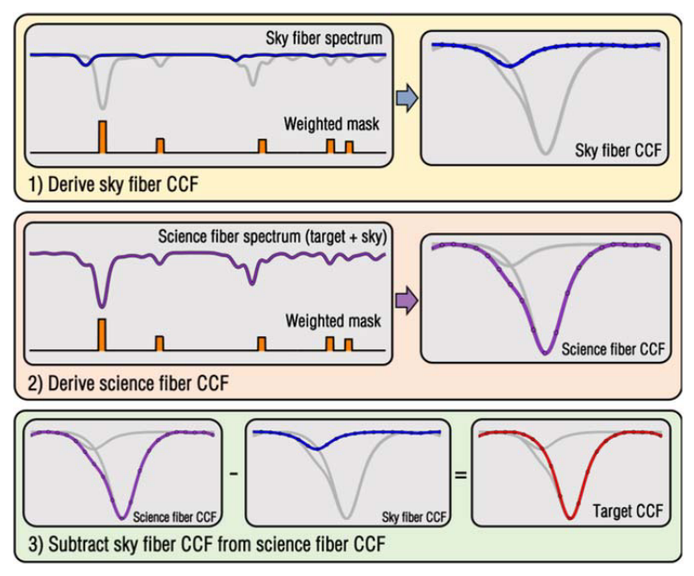
Solar Contamination
Roy et al. 2020
Notes:
Why is this a problem
How it creeps into CCF
Remove it in the CCF
This is ONE of the methods proposed

Slide 57
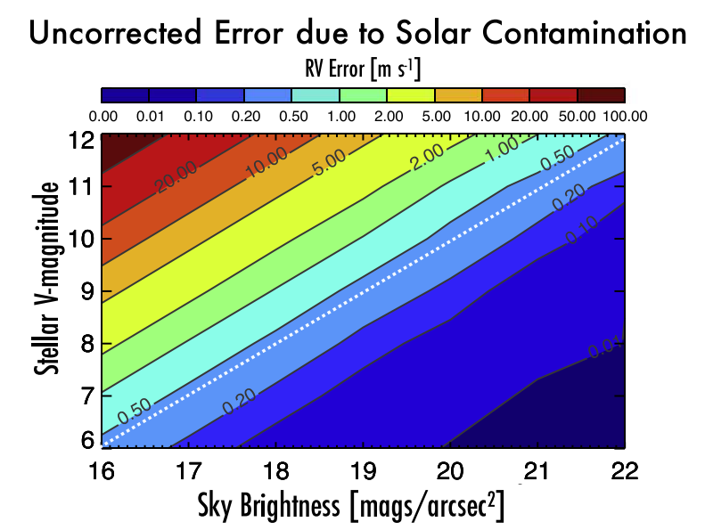
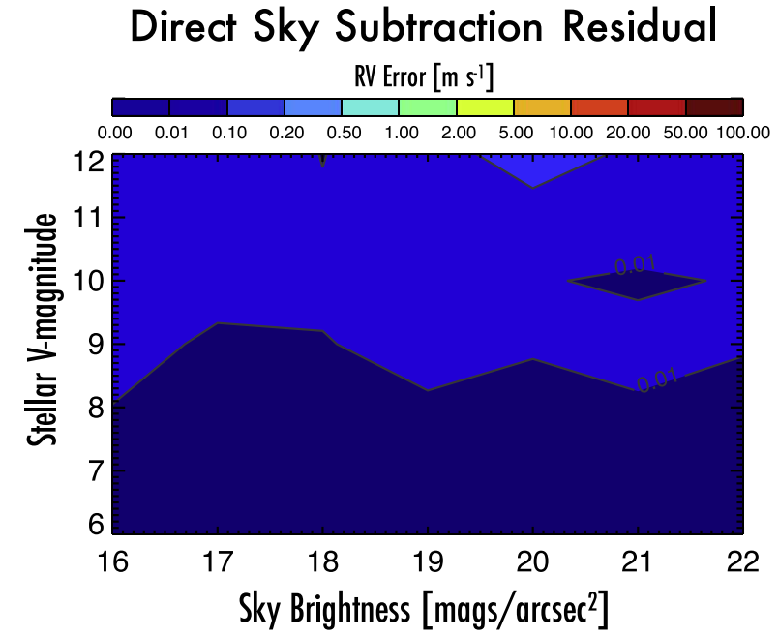
Solar Contamination
Before
After
No photon errors.
Roy et al. 2020
Notes:
Synthetic data
Relies on using solar spectrum, which is a good model for solar contamination.
But for telluric emission, good models often don’t exist…
But at least they are not everywhere like the…

Slide 58
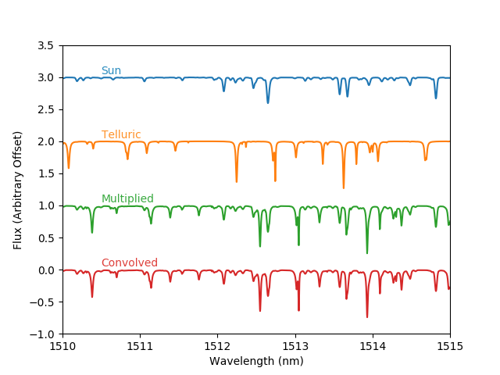
Telluric Absorption
Star
Observed (broadened)
Ref: Cullen Blake’s talk.
Wang, Latouf, et al. 2020 in prep.
Notes:
See Cullen’s talk
How tellurics enter the problem

Slide 59
Telluric Absorption
Star
Divide or Model
Observed (broadened)
Wang, Latouf, et al. 2020 in prep.
Notes:
How to deal with it under standard frames?

Slide 60
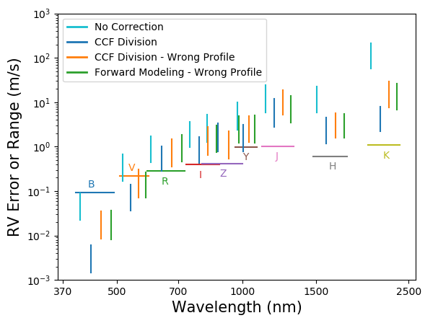
Telluric Absorption
Optical ~ 10 cm/s
NIR ~ 1 m/s
No photon errors.
Wang, Latouf, et al. 2020 in prep.
Notes:
How well did we do?
Error induced by tellurics as a function of wavelength
Different observing bands.
Light blue color.
Dark blue color.

Slide 61
Fun Fact # 2
When we know the telluric absorption lines perfectly, dividing them out then performing CCF does not eliminate the errors completely. Why?

Slide 62
Fun Fact # 2
When we know the telluric absorption lines perfectly, dividing them out then performing CCF does not eliminate the errors completely. Why?
Convolution does not distribute
over multiplication!

Slide 63
Fun Fact # 2
Star
Convolution does not distribute
over multiplication!
Observed (broadened)

Slide 64
Errors in Mearing RVs
Photon error
Mask or Template
Contamination
Stellar Variation
√
√
√

Slide 65
Stellar Variation
z = z_{star} + z_{planet}
t = t₀
t = t_{e}
Ref: Talks by Heather Cegla, Annelies Mortier, Jennifer Burt
Notes:
Standard methods do not distinguish between Doppler shifts and line deformation.

Slide 66
Non-standard methods for measuring RVs.
“Grand Solution” Style (Jeff Valenti)
Jeff Valenti and BJ Fulton on HIRES data
Gao et al. 2016 for CSHELL and iSHELL on IRTF
wobble, Bedell et al. 2019
Gaussian Process
PSOAP, Czekala et al. 2017
Rajpaul et al. 2020
Others
Machine learning (Davis+2017), neural network?
Other statistical/numerical method teasing out only Doppler shifts

Slide 67
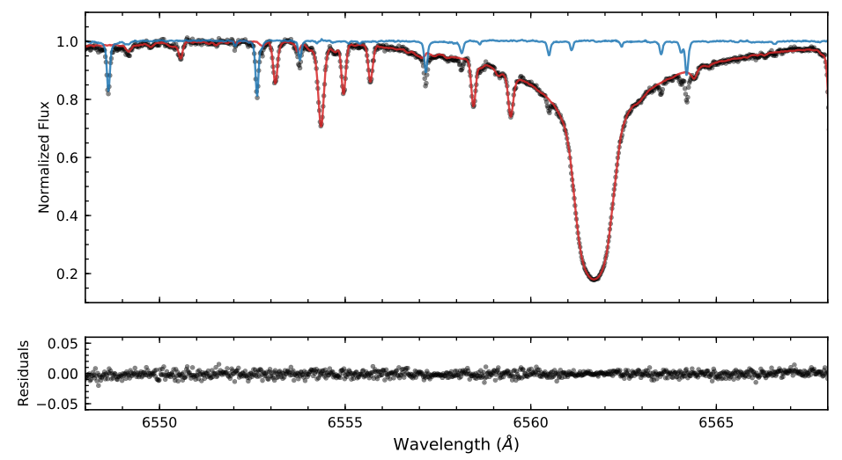
No prior knowledge required.
Globally solving for
Stellar spectrum
Telluric spectrum
All RVs!
wobble, Bedell et al. 2019

Slide 68
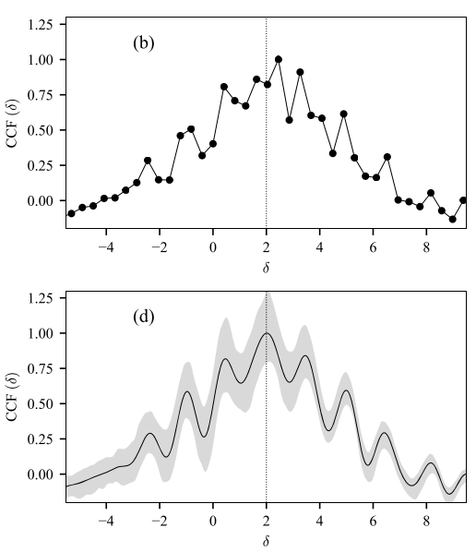
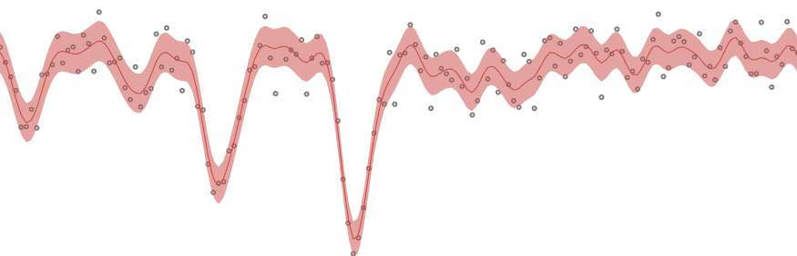
Pair-wise extraction of RVs with GP regression
example GP fit
RVs from each pair of spectral orders within a pair of observations
Determine the “contaminated” orders post extraction
Rejecting “contaminated” orders
CCF is continuous!
Ref: Vinesh M. Rajpaul’s talk on GP; Rajpaul et al. 2020

Slide 69
Errors in Mearing RVs
Photon error
Mask or Template
Contamination
Stellar Variation
√
√
√
√

